Slide 1
Putting ‘Visual’ in ‘Audio-Visual Recognition System’
Alex Zhang
Michal Zak

Slide 2
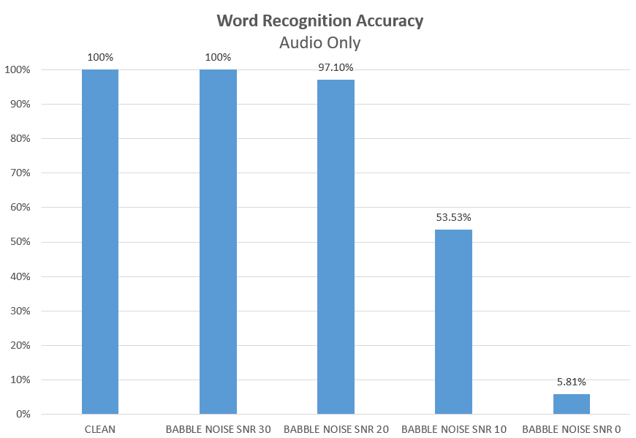
Why bother with visuals?
Audio noise impacts audio recognition performance drastically
Visual features do not get affected by audible background noise
Boost the accuracy by combining both features?
Notes:
MICHAL - SLIDE 2 - WHY BOTHER WITH VISUALS
Why bother with visuals?
Because audio is not enough.
Audio only speech recognition fails when background noise is introduced.
The accuracy drops to as low as 6% with SNR10.
The idea is the if we can get good enough performance from the visual features we could combine them with the audio features to boost the overall accuracy in noisy environments.
That is the basis for the hypothesis we’ll try to prove with our system over the course of this presentation.

Slide 3
HYPOTHESIS The recognition performance in low SNR conditions will improve once the visual component is added
Notes:
MICHAL - SLIDE 3 - HYPOTHESIS
Is our visual speech recogniser going to be good enough to confirm this hypothesis?
First, let’s get a little background information on how the problem of visual speech recognition is being tackled by other researchers.

Slide 4
Popular Visual Extraction Approaches
Well defined acoustic feature extraction: MFCC/LPC
Many ways to extract visual features - no industry standard
Common approach:
Estimate lip geometry
Mouth motion estimation based on optical flow
Intensity based features
Active shape model
Notes:
ALEX
LPC - linear predictive coefficients
There are many published techniques but no one standardized technique to do it. Mostly based on a mixture of techniques and comparing their performance with others.
Estimate lip geometry using image filtering and statistical interpretations techniques. Make use of shared database so it is very accurate.
Lip motion estimation measures the movements on the contour of the mouth. For example, we can tell there are more vertical movements than horizontal at the contours.
Lips not the only factor, we can have position of tongue, teeths etc. Find the area of teeth or its distance from the center of mouth.
Use bezier curves to represent the lip shape. Take the ratio of feature points on the curve. Best if your face has golden ratio.
We used similar approach to #1 and #2
MICHAL’S COMMENT - JUST MENTION THE ONES WE USE

Slide 5
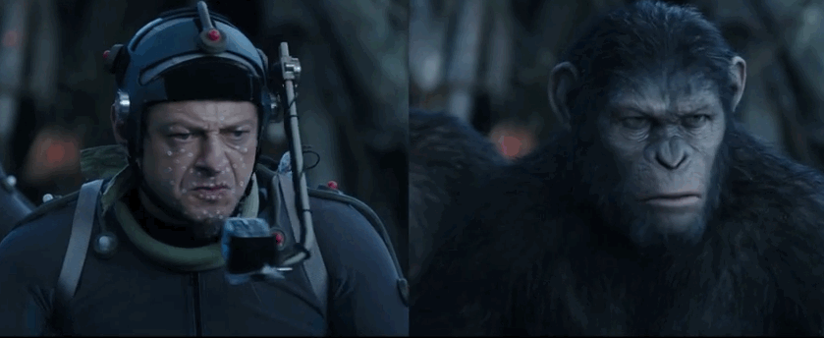

Our approach
Marker tracking
painted on green dots
lip mask extraction
Features
Width and height of mouth
Marker distances to center of mouth
Inner mouth area (teeth, dark areas)
Low frequency representation of mouth image using DCT
HOLLYWOOD-LEVEL MARKER TRACKING
UNDERGRADUATE-LEVEL MARKER TRACKING
Notes:
MICHAL - SLIDE 5 - OUR APPROACH
Inspired by motion tracking techniques used in Hollywood films we decided to paint little green dots on Alex’s face hoping this would give us a good basis for isolating the mouth region.
And here’s the list of features we managed to extract in the end. We’ll talk about them in a second.

Slide 6
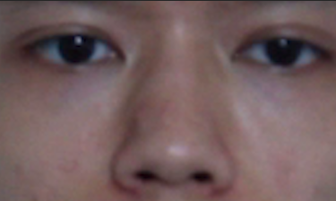
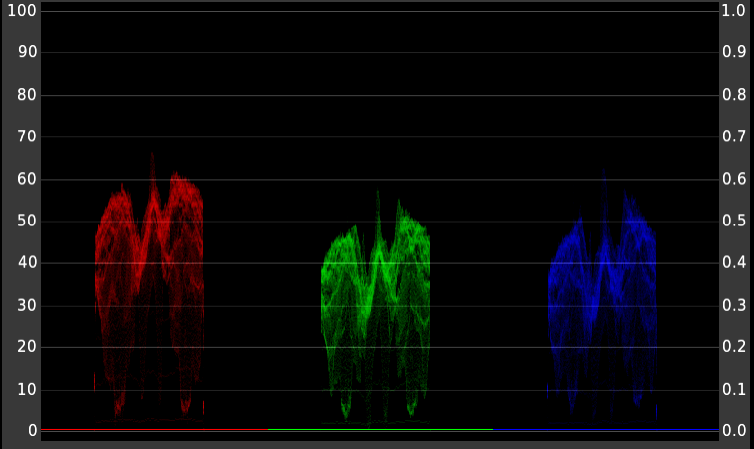
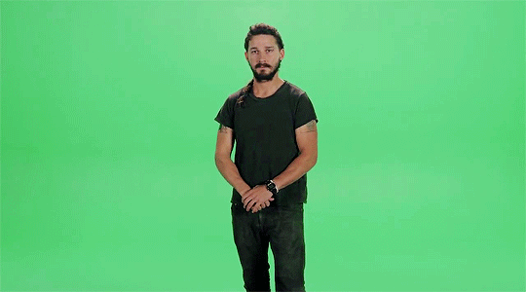
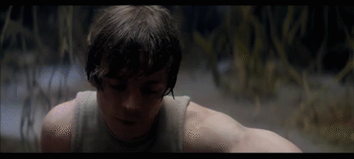
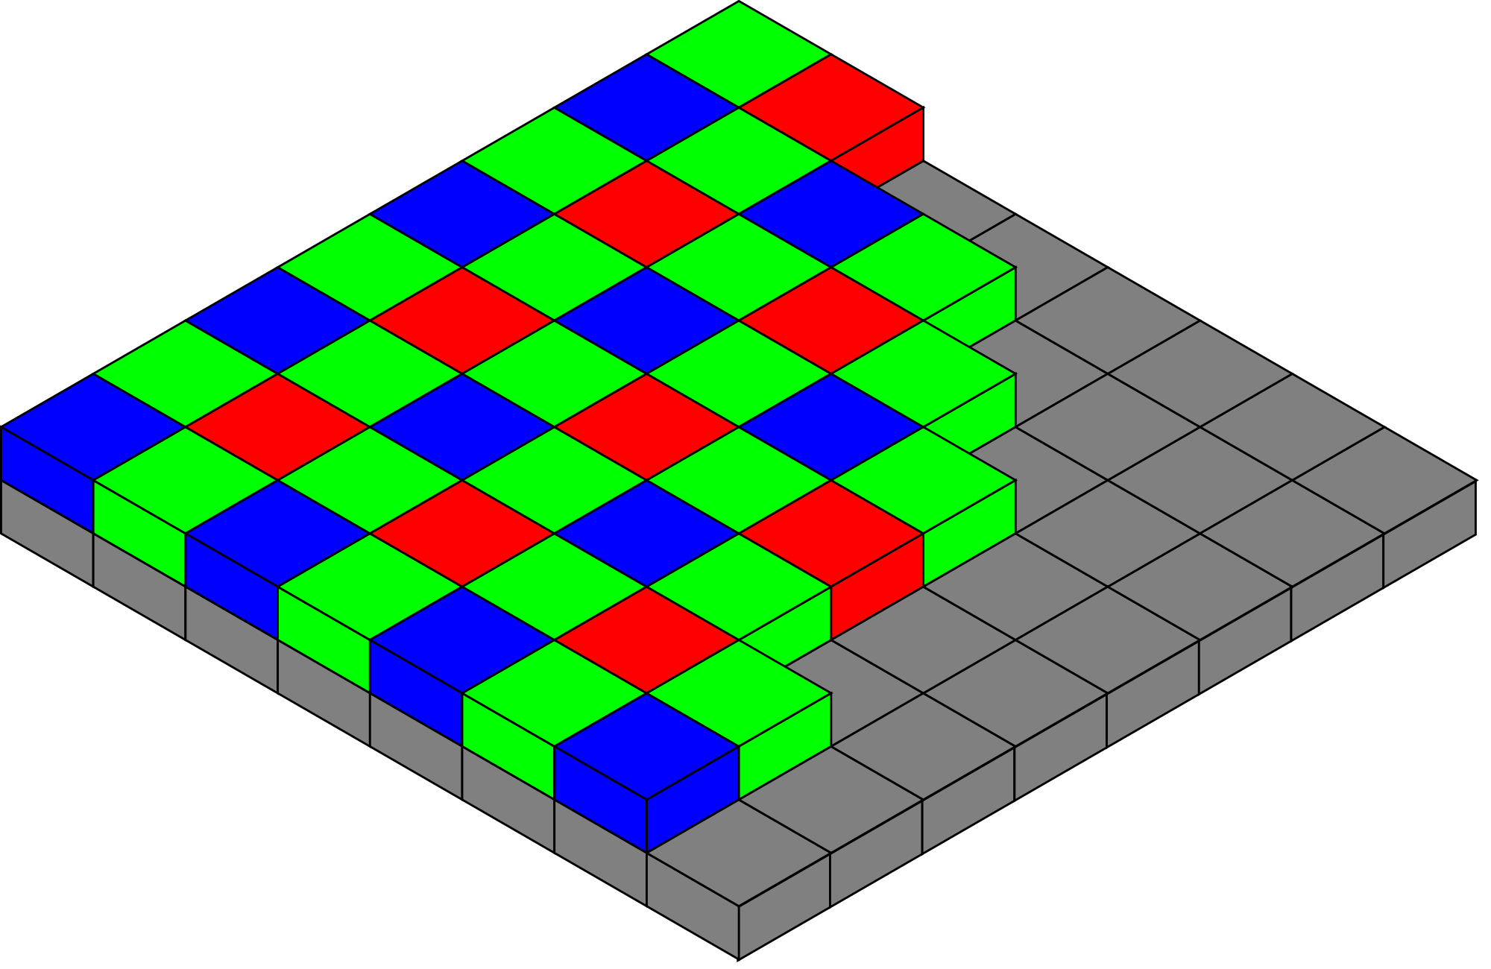
Why green?
SKIN TONE ANALYSIS USING RGB PARADE
CREATIVE USE OF CHROMA KEYING
‘GREEN-SCREEN’
BAYER PATTERN USED IN CMOS SENSORS
Notes:
MICHAL - SLIDE 6 - WHY GREEN?
But why were the dots green?
Three reasons.
1. Chroma keying - the technique of removing the background behind a moving object. The green is commonly used as the background colour.
2. Green markers, because of the perceived luminance and the fact that there’s not a lot of it in the human skin, just stand out.
3. The DSLR camera we used for our recordings uses CMOS(complementary metal-oxide semiconductor) sensors which feature a Bayer Pattern filter to generate the image. This filter generates twice as much green information as red or blue

Slide 7
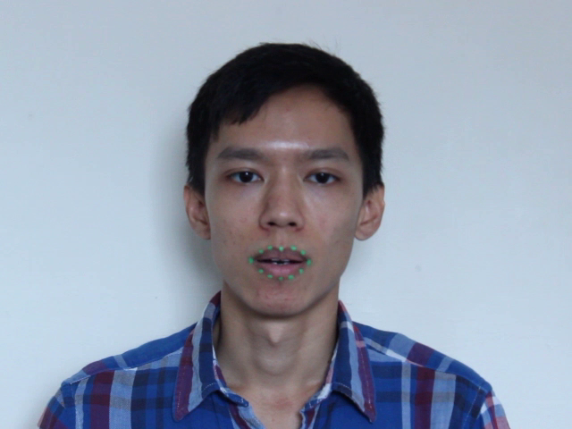
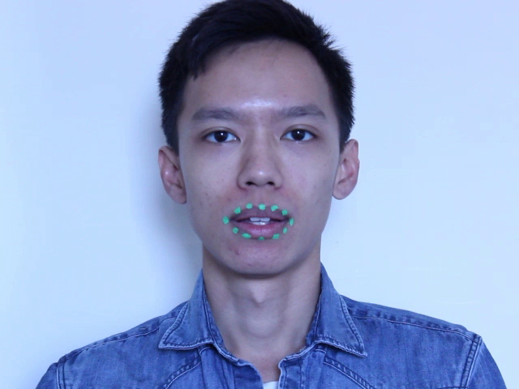
Data set - recording specs
Resolution: 640 x 480
Framerate: 25 fps
Format: .mp4 container
h264 encoding
Recorded on two different days - white balance and lighting conditions mismatch - slight differences in framing
20 VIDEOS
21 VIDEOS
FRAME FROM TRAINING VIDEO
FRAME FROM TEST VIDEO
Notes:
MICHAL - SLIDE 7 - DATA SET RECORDING SPECS
One of the biggest problems we had to face was the mismatch between training and testing videos.
They were recorded on two different days.
Not a good idea when you want to train the model on one and test on the other.

Slide 8
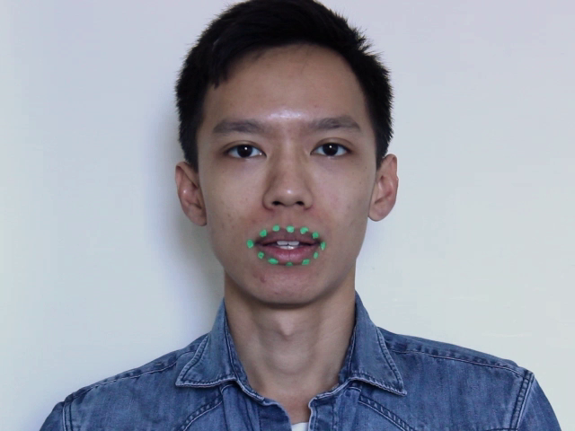
Data set issues - colour correction
FRAME FROM TRAINING VIDEO
FRAME FROM TEST VIDEO
Notes:
MICHAL - SLIDE 7 - DATA SET COLOUR CORRECTION
First issue you can see immediately is that the tone of the frames is not exactly matching
[CLICK]
Modified the warmth of the image
The green became ‘greener’ and less blue so it was easier to pick up - this increased the recognition accuracy

Slide 9
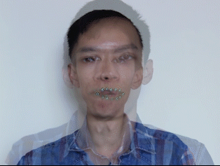
Data set issues - difference in framing
TRAINING AND TEST VIDEOS OVERLAYED
Notes:
MICHAL - SLIDE 9 - DATA SET DIFFERENCE IN FRAMING
The second problem was the differences in framing.
It was not severe but forced us to ditch the easy hard-coded cropping box and implement an algorithm that would move the position of the box on a frame by frame basis. Alex is going to talk a bit more about that later.

Slide 10
Implications of the data set issues
Problem:
awful results when using only training videos as the train set and only testing videos as the test set
Solution:
a lot of testing
mixing sets so that they both include half of recordings from the different days
Best result:
Train set
first half of training videos
second half of testing videos (more utterances)
Test set
second half of training videos
first half of testing videos
Notes:
MICHAL - IMPLICATIONS OF THE DATA SET ISSUES
Even after colour correction and modified bounding box algorithm the lighting conditions and variation in the mouth size affected the results.
We had to create a new data set for training and testing which combined videos from both days.

Slide 11
STEP ONE
OBTAIN THE LIP MASK
Notes:
MICHAL - SLIDE 11 - STEP ONE
Once we found our ideal data set we proceeded to the first step of feature extraction. Obtaining an accurate lip mask.

Slide 12
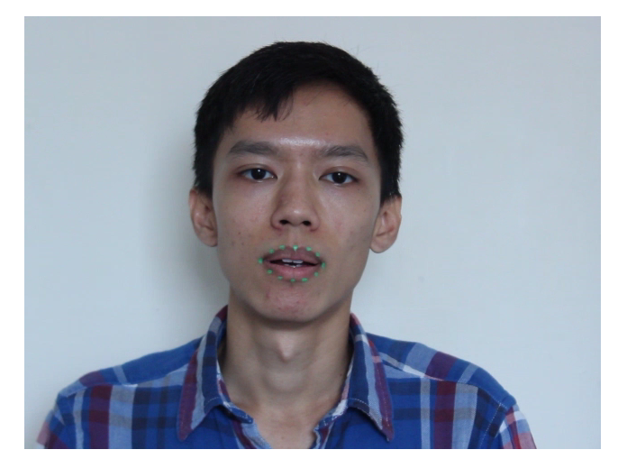
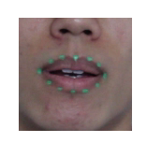
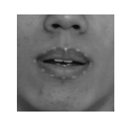
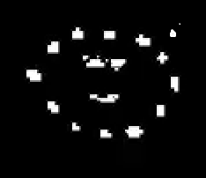


5 steps to build a lip mask
ORIGINAL FRAME
1
2
3
4
5
Crop frame to lip region
Find green markers
Remove artefacts
Reconstruct any missing markers
Construct mask polygon
Notes:
We know what kind of visual features we want - width height, marker distances, dct of lips, now how do we get them?
Idea is to find the green markers around the lips to form a masking polygon that will crop out irrelevant areas of image.
Image filtering techniques introduces many artifacts (extra pixels that are not makers).
Missing marker positions due to aliasing in video, how to estimate position of missing markers.
ALGORITHM NEED TO WORK FOR ALL TEST AND TRAINING SETS, different lighting, framing conditions

Slide 13
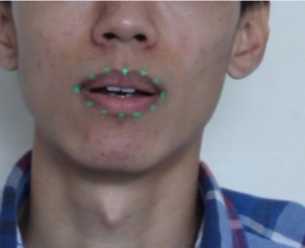
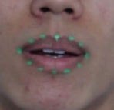
Crop the frame
ORIGINAL FRAME
FIRST CROP
SECOND CROP
How do we crop?
Rough crop to find mouth markers.
Find markers
Find center point
Make a fixed sized bounding box crop
Why crop?
Less pixels to compute
Reduce artifacts introduced by image filtering
Fixed frame dimension
Notes:
First frame: A hard coded rectangle crop because we know where the mouth is in all our videos.
Subsequent frames: a fixed sized bounding box is made at the center point to fit as tightly all the markers.
Need to crop frame to reduce amount of data to process. Imaging processing is slow. 300x300 = 90000 pixels.
Also reduces artifacts in data (erroneous green pixels due to thresholding) that occurs outside of the mouth due to image filtering.
Fixed bounding box so that we can run the DCT on the frame, results would not be useful with varying size DCT.

Slide 14
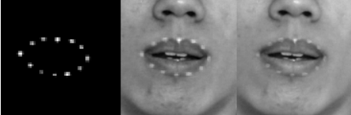

Extract green pixels
Two methods to filter out green pixels
Test pixel color ratio
g > r && r > b
Green pixel intensity threshold
Value = Diff green channel and grayscale
Value > threshold = 1
Many wrong pixels pass the test cases, but all marker pixels are present
‘Gray’ pixel [121 125 120]
Same threshold for all frames
Notes:
Pixel is passed if green component value is larger than the value of red and blue, respectively.
Picks out all green markers, but pixels that are not perceptually green is picked out as well - grey areas on face, white teeth.
Difference of green channel and grayscale image, we will be left with distinct green regions bitmap. Grayscale computed using rgb2gray.
Pass pixels larger than a threshold. We know the brightest pixels are likely to be the markers.
Want to dynamically find this threshold.
Green markers are not always ‘green’ throughout the frame. Thresholding need to be adjusted dynamically.
Image filtering function is applied across all pixels, does not take account of location information.

Slide 15
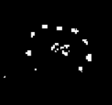

Nasty artefacts
Take logical intersection of the two results from green marker filtering
Removed many erroneous pixels
Some specks still remain
Cannot use bwopenarea() to remove small pixels - excluding lip markers
Artefacts are local to certain regions
Inner mouth (teeth, dark areas)
Outside of mouth (face, neck, background)
Notes:
Take logical intersection to remove as manyerroneous pixels as possible.
Some will still remain because filtering function is applied uniformly for each pixel, can’t accommodate for all cases.
Cannot remove pixels that have small area because we do not want to exclude any lip marker.
Fortunate all the artifacts are present in specific regions.

Slide 16


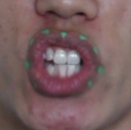
Remove inner mouth artefacts
Inner mouth artefacts
Teeth
Pass pixels r:g:b ratio near 1
Pass pixel intensity > average
Dark areas inside mouth
Pass pixel intensity < average
Varying sized circle at center
Notes:
For erroneous pixels occurring near center of mouth, we create a mouth mask containing 3 distinct shapes.
Circle fixed at the center of mouth that adjusted its size as the mouth opens and closes, want to cover as much area as possible
This is to remove pixels where the two previous mask can’t detect, because they are also calculated using some image processing function.
Teeth filtering, basically determine which pixels are ‘whiter’.
Pass pixels with r:g:b ratios close to 1.
And pass pixels that are brighter than average.

Slide 17

2 problems left
Two Problems
Regions may occur outside of the ring of markers
Less than 12 markers are available
Process runs in a loop
Increase green intensity threshold every iteration
Until maximum of 12 regions are left
Notes:
We want to determine the optimal cutoff value during Type 2 green pixels testing.
Repeat the above process, increasing the threshold variable on each iteration, and count the number of regions.
Break out of the iteration when there are 12 or less regions determined by regionprops.
These will represent the closest estimate of our lip markers.
Regions may occur outside of the

Slide 18
Problem 1
Artifacts in surrounding areas of mouth
Remove regions that stray too far from the ring of markers
Sort regions by euclidean distance from center
Get difference of adjacent values
Region is considered stray when
Is near the end of the list (far)
difference > threshold
Notes:
We remove regions that stray too far away from the central ring of regions.
Sort regions by their euclidean distance from the center point.
Find the difference of adjacent values and pick out those regions with values higher than a set threshold
Remove those regions only if they are the the farthest few regions in the sorted list.

Slide 19

Problem 2
Need to have 12 full markers at all times
If markers < 12, compare with previous frame to find which marker is missing.
Use k-nearest neighbor search by matching their direction vectors
Take old position and add weighted velocity of two closest neighbors
More weight if neighbor is closer to missing marker
More weight if marker at bottom of mouth
Reestimate the center point at end
Notes:
We can find which markers points are missing by comparing the list of markers to the one in the previous frame, which have all 12.
The current markers are matched to the old markers in last frame and we can see which marker is missing. It is done using k-nearest neighbor search on the directional vector.
We now have to estimate the position of the new marker by taking the weighted velocities of the nearest 2 neighbors and adding it to the new marker position from the last frame.
The velocity is weighted by how far its x value is from the center, so missing markers at the bottom the lips get more velocity than markers at the sides, like how the actual mouth moves.
We then reestimate the center point from these 12 markers.

Slide 20
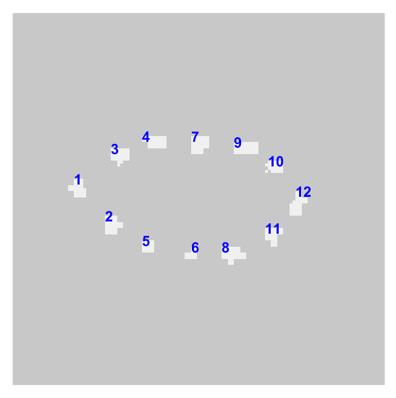
Working with markers as objects
Functions we use
bwlabel() - inbuilt
finds and labels white objects from the binary image
regionprops() - inbuilt
obtains properties of those objects
in our case we use ‘Centroid’ - position of the centre of mass of each object
vislabels() - by Steve Eddins*
visualizes the output of bwlabel()
ORIGINAL FRAME
vislabels() OUTPUT
BINARY MAP OF MARKERS
*http://uk.mathworks.com/matlabcentral/fileexchange/19665-visualize-output-of-bwlabel/content/vislabels.m
Notes:
MICHAL - SLIDE 20 - WORKING WITH MARKERS AS OBJECTS
Once we’ve got our 12 markers and they don’t disappear we convert them into objects and obtain their properties, mainly the position of the centre of mass for each object

Slide 21
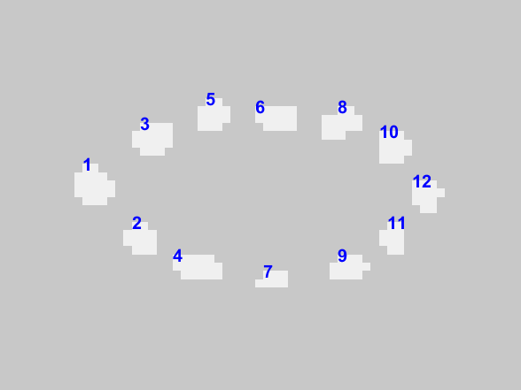
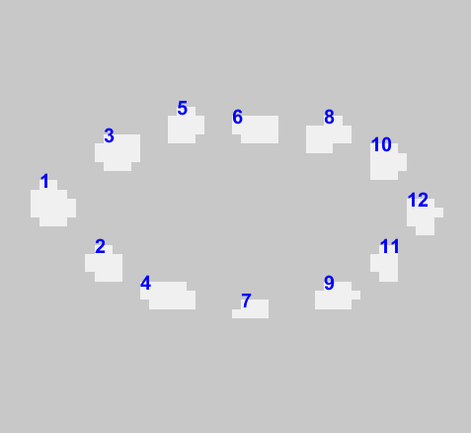
Some problems with marker objects
The ordering is not consistent across frames and videos
The original ordering does not enable us to create a polygon
Notes:
MICHAL - SLIDE 21 - PROBLEMS WITH MARKER OBJECTS
The problem we face is that the ordering of the objects is not consistent.
-look at number 4 for example
CLICK
It’s that way because the function bwlabel() scans the image leftmost and then topmost
Why does it matter? Well, try connecting the dots the way they are ordered
CLICK
This doesn’t allow us to create a nice polygon

Slide 22
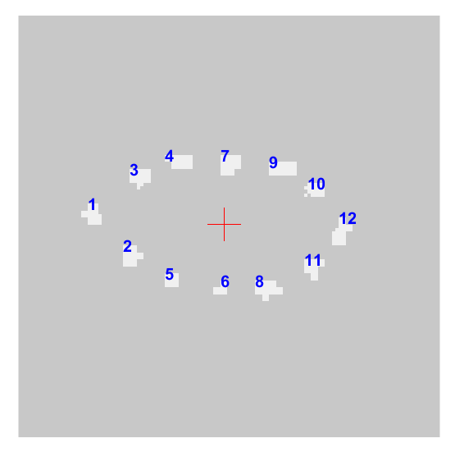
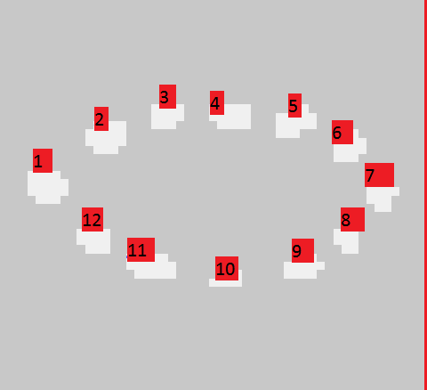
Centre point to the rescue
Guide to sorting the markers in the clockwise order
Obtain centre point by taking the mean value of all markers
Get alpha angle value between centre point and each marker with regards to Y axis
Sort the markers ascending based on that value
Profit. Now you can connect the markers to make a mask
α
Notes:
MICHAL - SLIDE 22 - CENTRE POINT TO THE RESCUE
What we want is a clockwise order which would enable us to connect all the dots and create a closed polygon.
The idea is that you can sort the markers by looking at the angle between each marker and the centre point.
We compute the center point of the mouth and then get the angle between each marker with regards to the centre points X axis.
We use those values to sort the markers in an ascending order
[CLICK]
VOILA

Slide 23
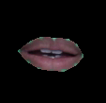
Lipmask
BINARY MAP OF MARKERS
LIP MASK
LIP MASK APPLIED TO ORIGINAL FRAME
Notes:
MICHAL - SLIDE 23 - LIPMASK
Once we got the markers ordered, we connect them and fill the inside creating a lip mask. WHen applied to the original frame we get a nice, isolated mouth area.
That’s the basis for our feature extraction.

Slide 24
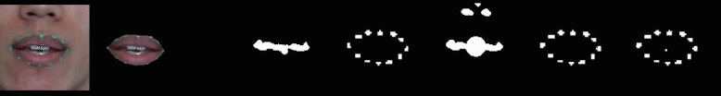
Lip mask extraction in motion
VIDEO
LIP MASK APPLIED TO VIDEO
FINAL INNER MOUTH MASK
FINAL MARKERS
FIRST INNER MOUTH PASS WITH ADDITIONAL CIRCLE
SECOND MARKERS PASS
FIRST MARKERS PASS
Notes:
MICHAL - SLIDE 24 - LIP MASK EXTRACTION IN MOTION
Here’s a nice eye-candy overview of some of the steps and passes we go through to end up with the inner mouth mask and the lip mask.

Slide 25
STEP TWO
EXTRACT THE FEATURES
Notes:
MICHAL - SLIDE 25 - STEP TWO
Here’s where the magic happens

Slide 26
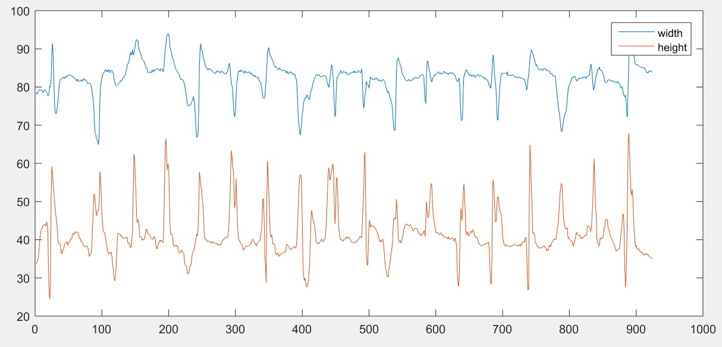
Feature 1 - Width and Height of Lips
How to obtain the feature:
Find the extremas of all the markers centre of mass positions (both in X and Y)
Subtract the smallest values from the largest values
X value subtraction is width Y value subtraction is height
Final feature vector: [width,height]
GRAPH SHOWING THE CHANGES IN WIDTH AND HEIGHT ACROSS ONE VIDEO FILE
Notes:
ALEX
18 peaks = 18 words uttered

Slide 27
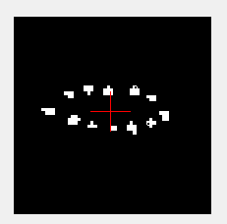
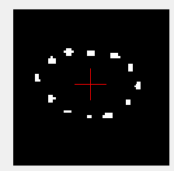
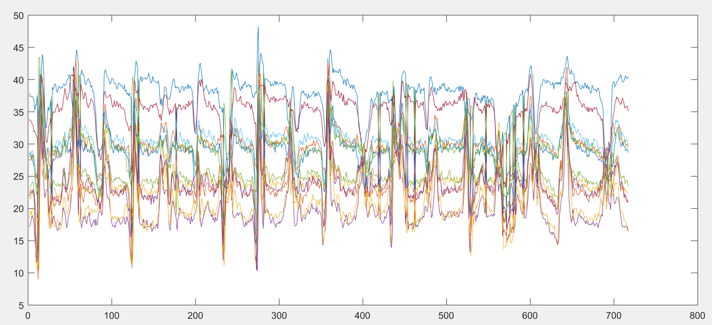
Feature 2 - Relative Distance of Markers to Centre Point
How to obtain the feature:
Use the matrix of sorted marker objects to calculate the Euclidean distance between each marker and the centre point
Final feature vector: 12 values (each marker tracked independently)
CLOSED MOUTH
OPEN MOUTH
CHANGES IN DISTANCE FOR 12 MARKERS ACROSS A VIDEO FILE
Notes:
ALEX
because our markers are sorted and there’s always 12 of them we can track their relative distance to the centre point which gives us a general idea of how each part of the lip changes when uttering a word

Slide 28


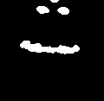
Feature 3 - Inner Mouth Pixel Count
ORIGINAL INNER MOUTH MASK
LIP MASK
ISOLATED INNER MOUTH MASK
Notes:
MICHAL - SLIDE 28 - INNER MOUTH PIXEL COUNT
The third feature vector is the inner mouth pixel count
Original algorithm picks up nostrils and specular reflection on the nose
In order to get rid of that we take a binary intersection between the original teeth/dark area mask and the newly acquired lip mask.
What we get in the end is the isolated mask which accurately shows the openness of the mouth.

Slide 29
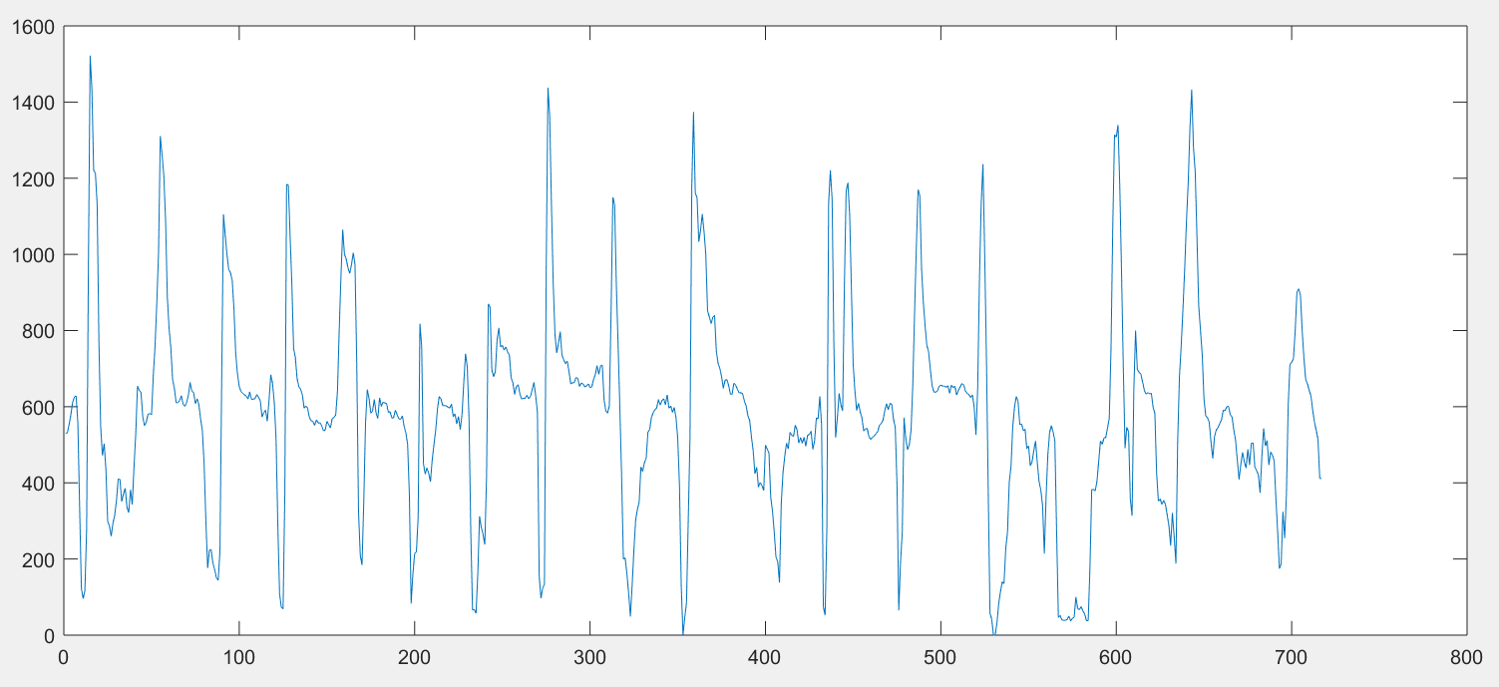
Feature 3 - Inner Mouth Pixel Count
How to obtain the feature:
Isolate the inner mouth area
Count the number of white pixels per frame
Final feature vector: 1 value - the number of white pixels that correlates to the openness of the mouth
ISOLATED INNER MOUTH MASK
CHANGES IN INNER MOUTH PIXEL COUNT ACROSS A VIDEO
Notes:
MICHAL - SLIDE 29 - INNER MOUTH PIXEL COUNT CNTD
We then count the number of white pixels which represent the openness of the mouth and there’s our third feature

Slide 30
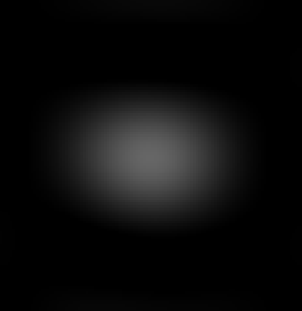
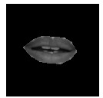
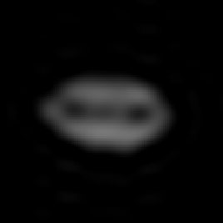
Feature 4 - DCT representation
How to obtain the feature:
Apply the lip mask to the original frame
Convert to greyscale
Apply dct()
Extract low-frequency information from the result
Final feature vector: 25 values (5x5 matrix) representing the low frequency mouth information
5x5 MATRIX
LIP MASK APPLIED TO ORIGINAL FRAME
(GREYSCALE)
15x15 MATRIX
Notes:
MICHAL - SLIDE 30 - DCT REPRESENTATION
The fourth feature is the low frequency representation of the lips obtained using the DIscrete Cosine Transform.
It converts the greyscale image into the frequency spectrum and from that we extract the top left corner of the matrix which contains only the low frequency information - the general shape of the mouth.
We found the 5x5 matrix to be the best for our mixed data. The increased resolution of the 15x15 matrix didn’t help when dealing with two different kinds of videos.

Slide 31
Which features do we use?
Width/Height + Marker Distance
good match
accuracy = ~35%
Inner Mouth Pixel Count + DCT
best match
accuracy = ~63%
Any other combination resulted in the decrease in accuracy
Notes:
ALEX
Interesting point about weighting in HMM prototypes:
We’ve conducted more 30 tests focused purely on getting the weights of those four streams right to get the best results
in some cases we found that ratio [0,2,0,2] is not equal to [0,1,0,1] as expected by instead shares the results with [0,2,0,1]. No idea why. Just one of the quirks of the HTK system.THe fact that the way the stream weights work is not at all documented in the HTK book we had to fine tune the values empirically through trial and error

Slide 32

Final Visual-Only Test Results
FEATURES
WEIGHT
1
63.49%
WORD ACCURACY
DCT MATRIX SIZE 5x5
4
INNER MOUTH PIXEL COUNT
Notes:
ALEX
CLICK
Nice result there, mate.

Slide 33

Final Combined Feature Vectors
50 VALUES
29 VALUES
AUDIO CEPSTRAL COEFFICIENTS
100 CHANNELS FOR LINEAR FILTERBANK / 2
5x5 DCT AND INNER MOUTH
25 + 4 * INNER MOUTH PIXEL COUNT
AUDIO STREAM
VIDEO STREAM
WEIGHT
[1,1]
Notes:
MICHAL - SLIDE 33 - FINAL COMBINED FEATURE VECTORS
We had to have 2 separate streams for audio and video.
In order to compress the video stream which was already comprised of multiple feature streams we brute forced the FOUR TO ONE weighting by copying the inner mouth pixel count value 4 times.
Let’s look at the hypothesis we set out early in the presentation.

Slide 34
HYPOTHESIS The recognition performance in low SNR conditions will improve once the visual component is added
Notes:
MICHAL - SLIDE 34 - HYPOTHESIS
Can we prove it with our results now?
<drumroll please>

Slide 35
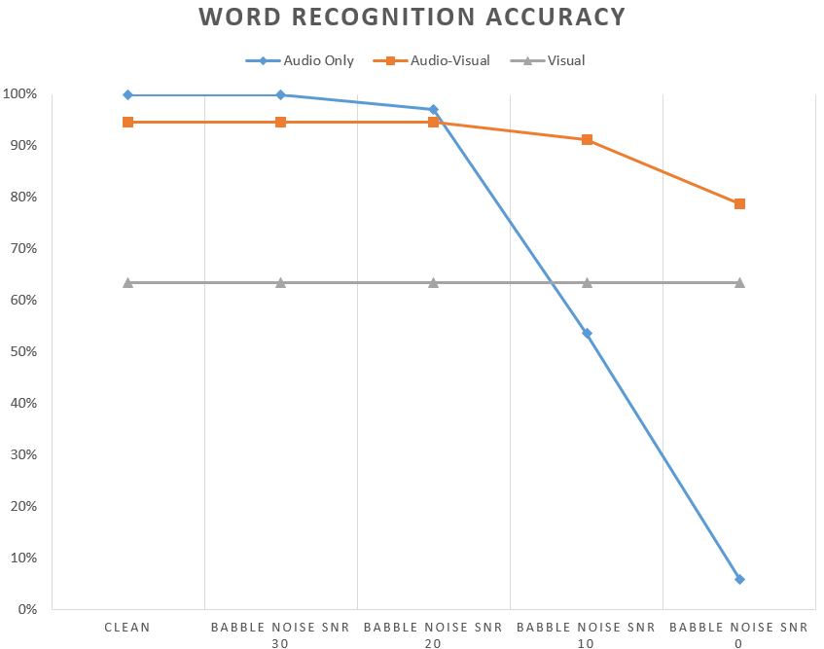

Final results
Visual speech recognition helps greatly when we introduce noise to the audio recordings
SNR10 - increase of ~38%
SNR0 - increase of ~73%
Notes:
MICHAL - SLIDE 35 - FINAL RESULTS
Yay
The combined audio-visual features improve the accuracy greatly in low SNR conditions. The difference is as much as 73% for SNR0.
[CLICK]
Mission accomplished

Slide 36
QUESTIONS?

